Slide 1

Overview
This project demonstrates the development of a Library Management System using SQL to efficiently organize and analyse library data.
Created and managed normalized tables for books, members, employees,
and transactions.
Performed CRUD operations to simulate real-world library database workflows.
Applied JOIN, GROUP BY, and HAVING clauses for advanced data retrieval.
Built summary tables using CTAS for tracking book issue frequency and rental
performance.
Showcases understanding of database design, data manipulation,
and query optimization.

Slide 2
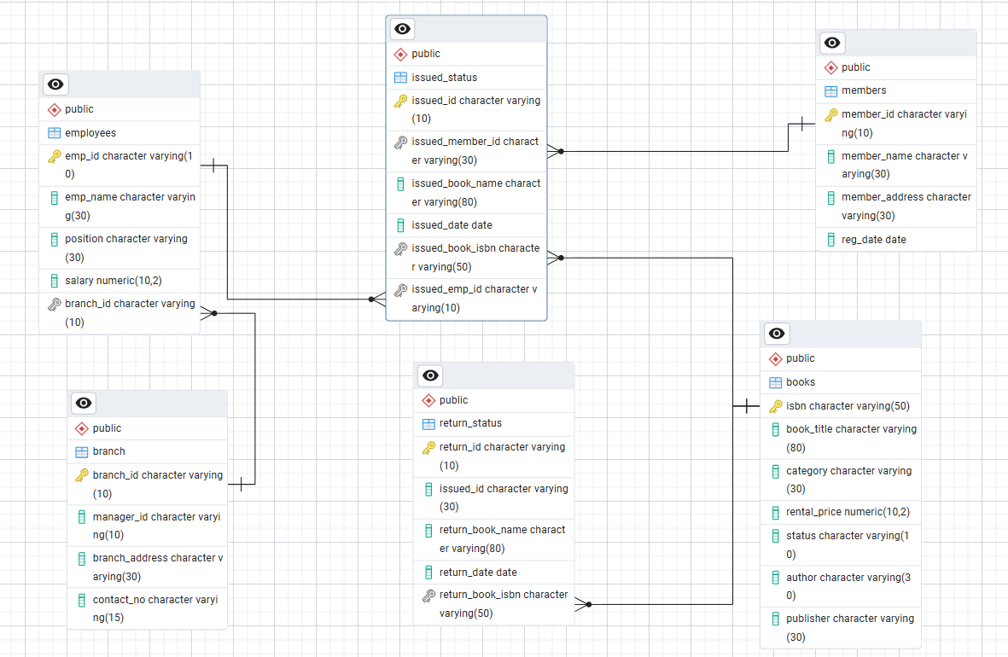
Project
Schema

Slide 3
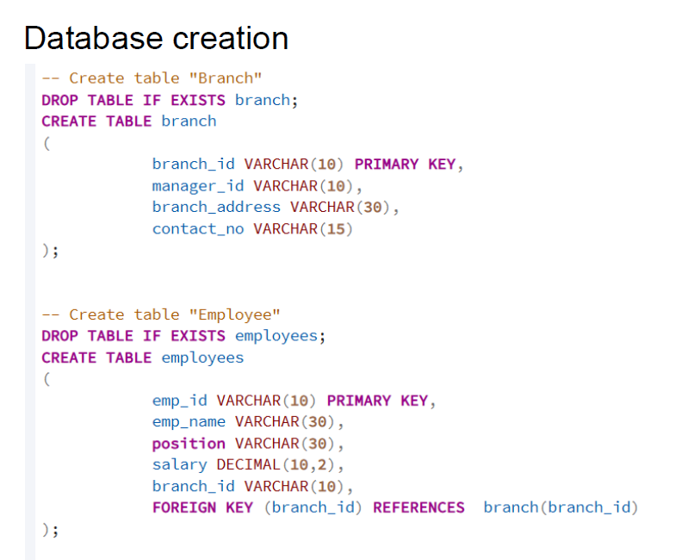

Slide 4
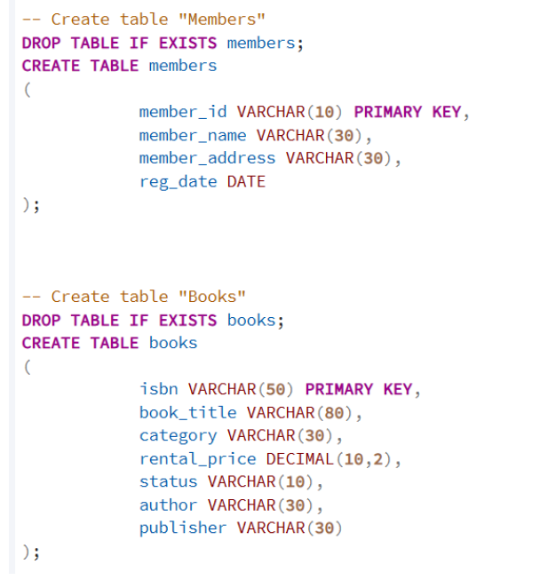

Slide 5
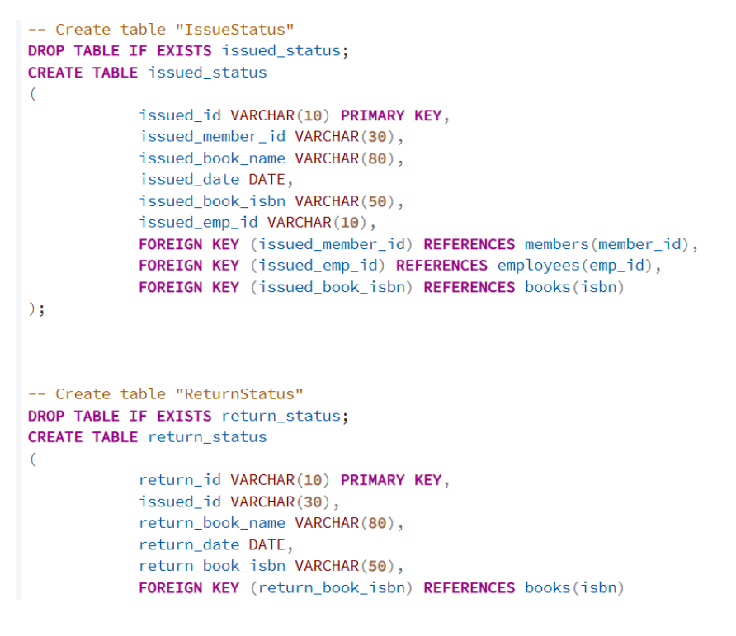

Slide 6
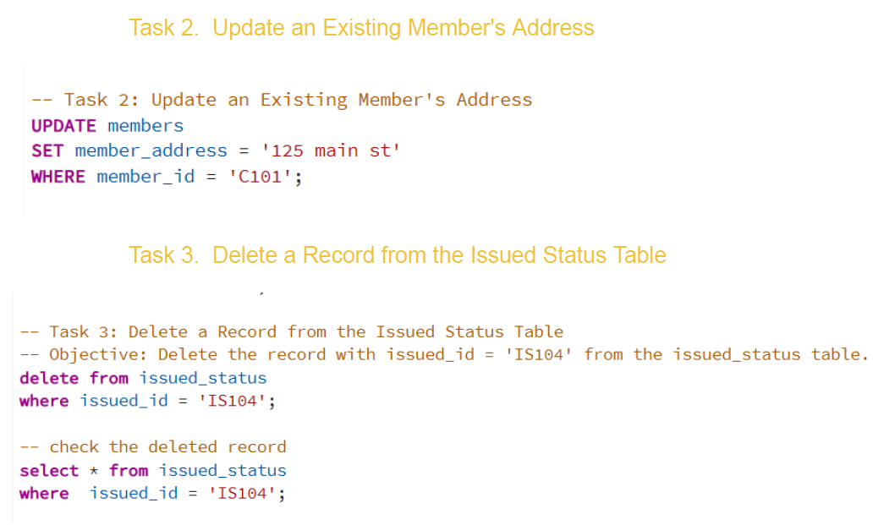
:
:
2

Slide 7
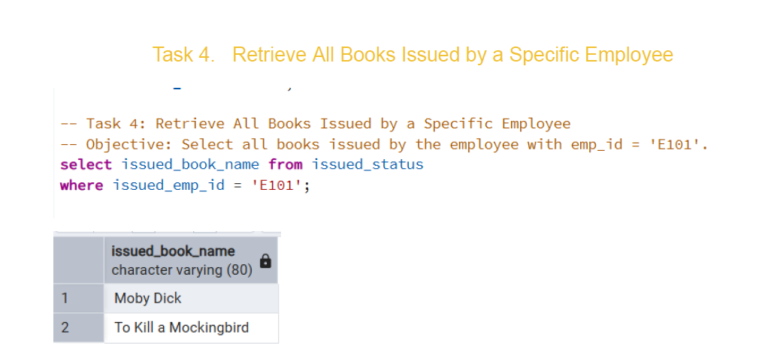
3
:

Slide 8

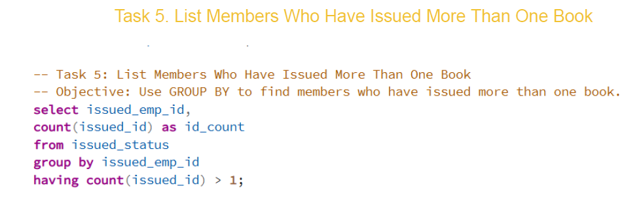
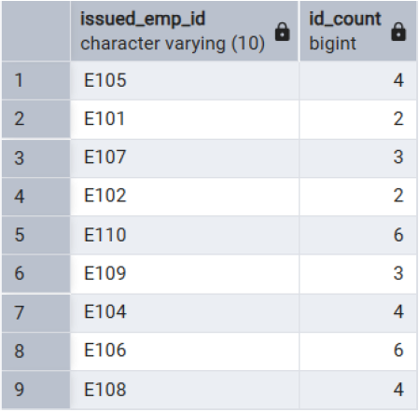
4
:

Slide 9
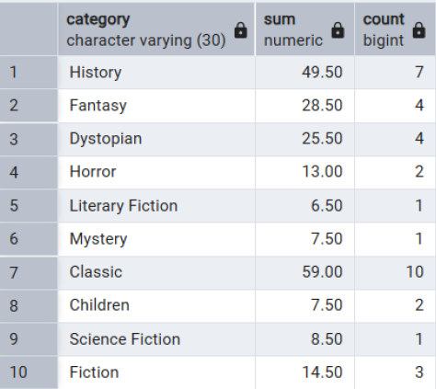
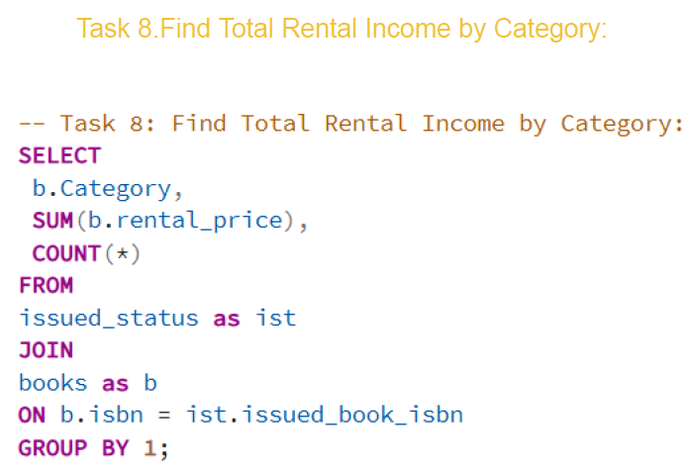
:

Slide 10
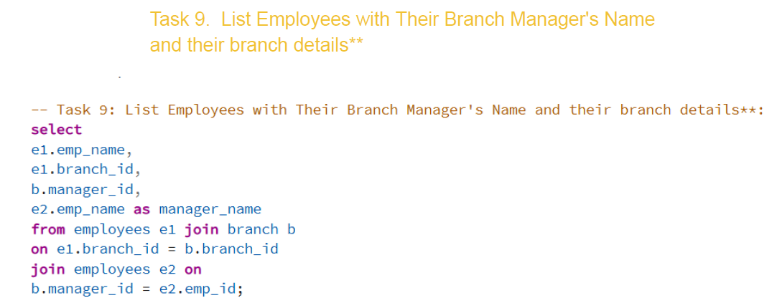
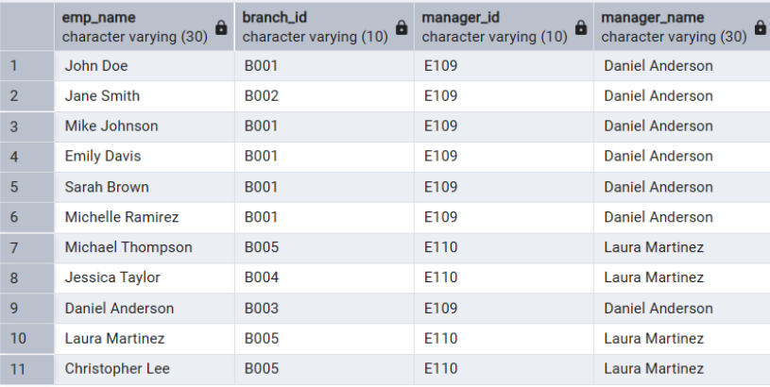
:

Slide 11
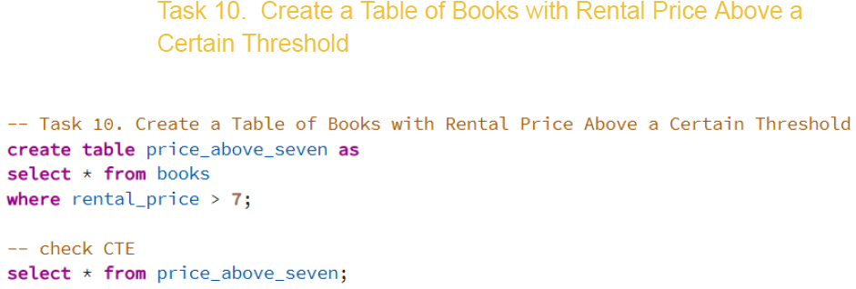
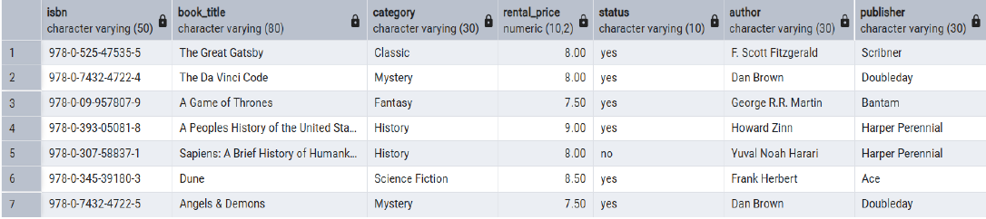
:

Slide 12
Conclusion
This project highlights the use of SQL for efficient library database management. It demonstrates capabilities in data handling, advanced querying , and analytical reporting, strengthening the foundation for data analysis and relational database design.

